Slide 1
What is Logistic Regression?
In a nutshell:
A statistical method used to model dichotomous or binary outcomes (but not limited to) using predictor variables.
Used when the research method is focused on whether or not an event occurred, rather than when it occurred (time course information is not used).

Slide 2
What is Logistic Regression?
What is the “Logistic” component?
Instead of modeling the outcome, Y, directly, the method models the log odds(Y) using the logistic function.

Slide 3
What is Logistic Regression?
What is the “Regression” component?
Methods used to quantify association between an outcome and predictor variables. Could be used to build predictive models as a function of predictors.

Slide 4
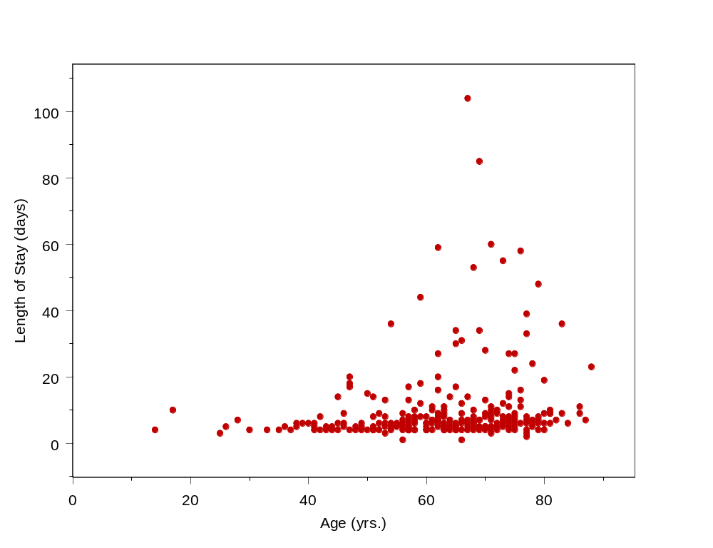
What is Logistic Regression?

Slide 5
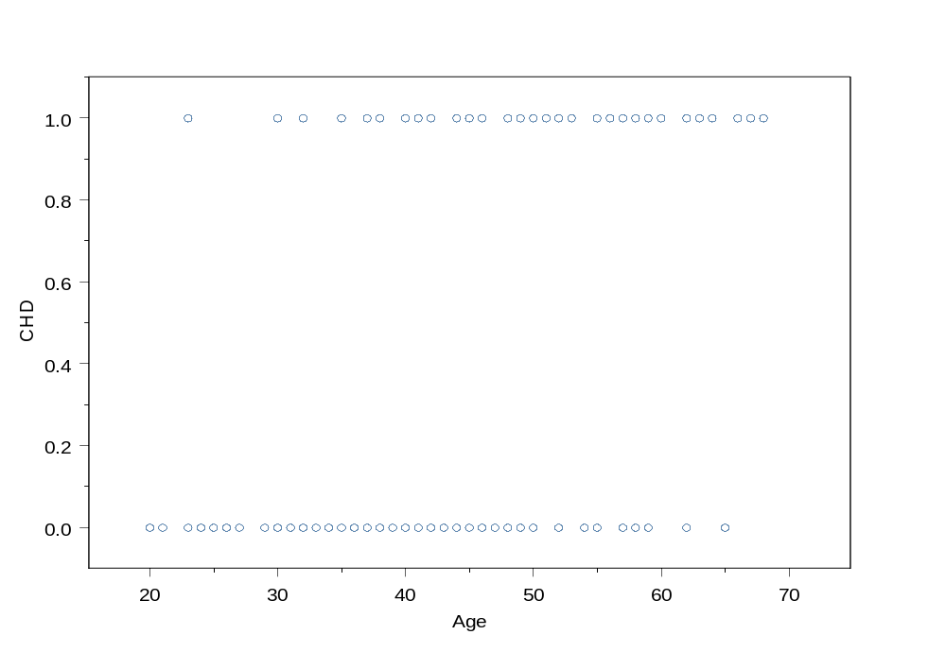
What is Logistic Regression?
100 day Mortality (Died=1, Alive=0)
Age (yrs.)

Slide 6
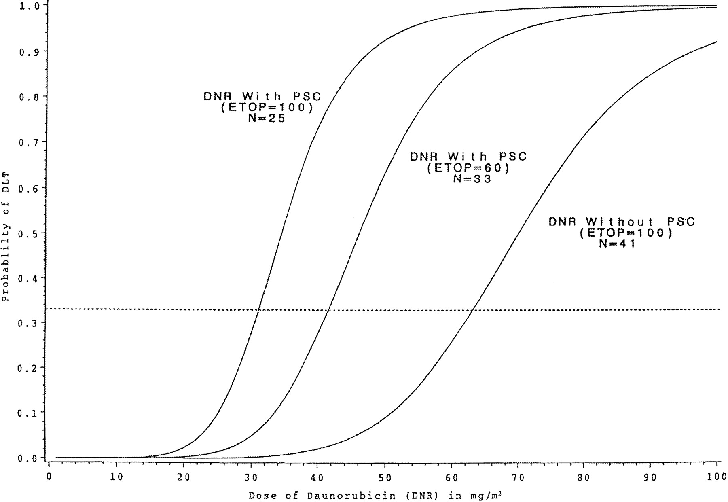
Fig 1. Logistic regression curves for the three drug combinations. The dashed reference line represents the probability of DLT of .33. The estimated MTD can be obtained as the value on the horizontal axis that coincides with a vertical line drawn through the point where the dashed line intersects the logistic curve. Taken from “Parallel Phase I Studies of Daunorubicin Given With Cytarabine and Etoposide With or Without the Multidrug Resistance Modulator PSC-833 in Previously Untreated Patients 60 Years of Age or Older With Acute Myeloid Leukemia: Results of Cancer and Leukemia Group B Study 9420” Journal of Clinical Oncology, Vol 17, Issue 9 (September), 1999: 283. http://www.jco.org/cgi/content/full/17/9/2831

Slide 7
What can we use Logistic Regression for?
To estimate adjusted prevalence rates, adjusted for potential confounders (sociodemographic or clinical characteristics)
To estimate the effect of a treatment on a dichotomous outcome, adjusted for other covariates
Explore how well characteristics predict a categorical outcome

Slide 8
History of Logistic Regression
Logistic function was invented in the 19th century to describe the growth of populations and the course of autocatalytic chemical reactions.
Quetelet and Verhulst
Population growth was described easiest by exponential growth but led to impossible values

Slide 9
History of Logistic Regression
Logistic function was the solution to a differential equation that was examined from trying to dampen exponential population growth models.

Slide 10
History of Logistic Regression
Published in 3 different papers around the 1840’s. The first paper showed how the logistic models agreed very well with the actual course of the populations of France, Belgium, Essex, and Russia for periods up to the early 1830’s.

Slide 11
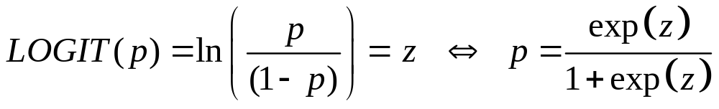
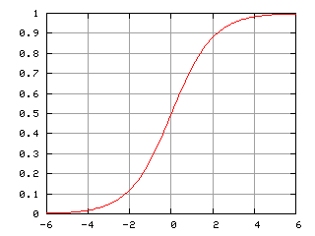


The Logistic Curve
p (probability)
z (log odds)

Slide 12
Logistic Regression
Simple logistic regression = logistic regression with 1 predictor variable
Multiple logistic regression = logistic regression with multiple predictor variables
Multiple logistic regression =
Multivariable logistic regression =
Multivariate logistic regression

Slide 13
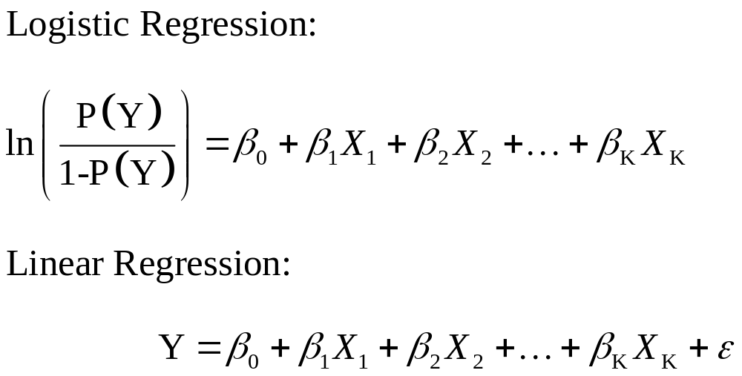
The Logistic Regression Model

Slide 14
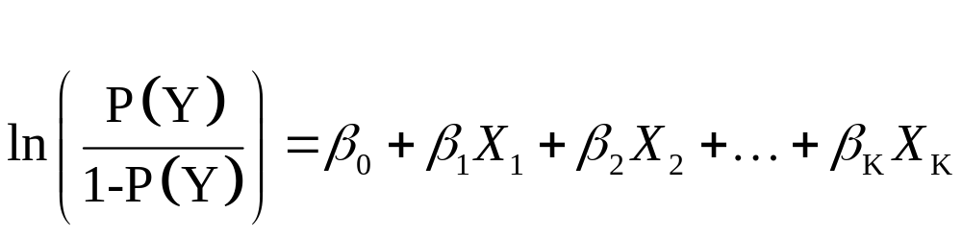
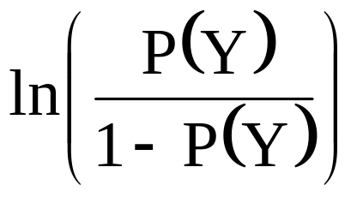
The Logistic Regression Model
predictor variables
dichotomous outcome
is the log(odds) of the outcome.

Slide 15
The Logistic Regression Model
intercept
model coefficients
is the log(odds) of the outcome.

Slide 16
Logistic Regression uses Odds Ratios
Does not model the outcome directly, which leads to effect estimates quantified by means (i.e., differences in means)
Estimates of effect are instead quantified by “Odds Ratios”

Slide 17
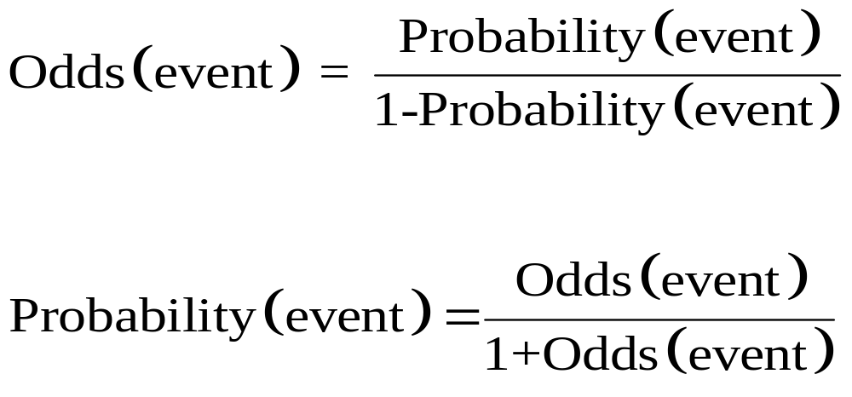
Relationship between
Odds & Probability

Slide 18
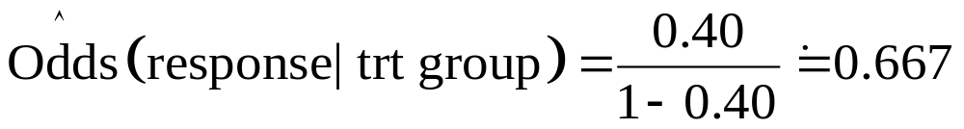
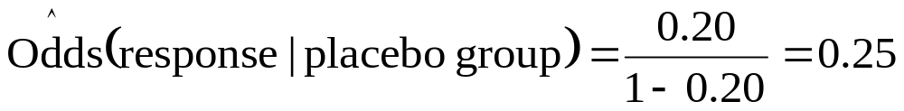
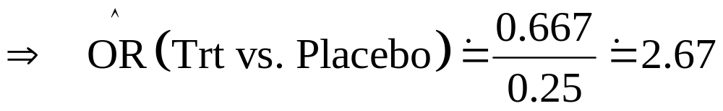
The Odds Ratio
Definition of Odds Ratio: Ratio of two odds estimates.
So, if Pr(response | trt) = 0.40 and Pr(response | placebo) = 0.20
Then:

Slide 19
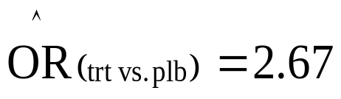
Interpretation of the Odds Ratio
Example cont’d:
  Outcome = response,
Then, the odds of a response in the treatment group were estimated to be 2.67 times the odds of having a response in the placebo group.
Alternatively, the odds of having a response were 167% higher in the treatment group than in the placebo group.

Slide 20
Odds Ratio vs. Relative Risk
An Odds Ratio of 2.67 for trt. vs. placebo does NOT mean that the outcome is 2.67 times as LIKELY to occur.
It DOES mean that the ODDS of the outcome occurring are 2.67 times as high for trt. vs. placebo.

Slide 21
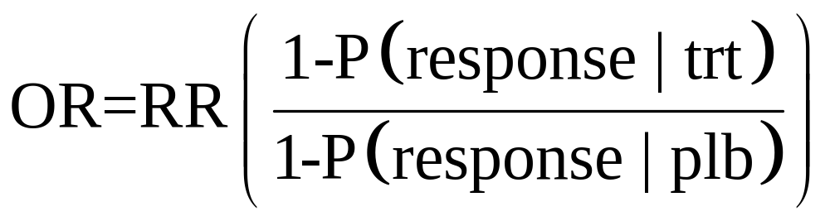
Odds Ratio vs. Relative Risk
The Odds Ratio is NOT mathematically equivalent to the Relative Risk (Risk Ratio)
However, for “rare” events, the Odds ratio can approximate the Relative risk (RR)

Slide 22
Maximum Likelihood
The method of maximum likelihood estimation chooses values for parameter estimates (regression coefficients) which make the observed data “maximally likely.”
Standard errors are obtained as a by-product of the maximization process

Slide 23
The Logistic Regression Model
intercept
model coefficients
is the log(odds) of the outcome.

Slide 24
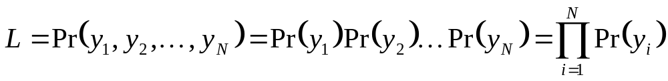
Maximum Likelihood
We want to choose β’s that maximizes the probability of observing the data we have:
Assumption: independent y’s

Slide 25
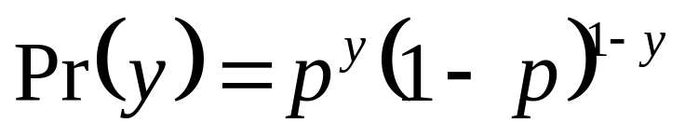
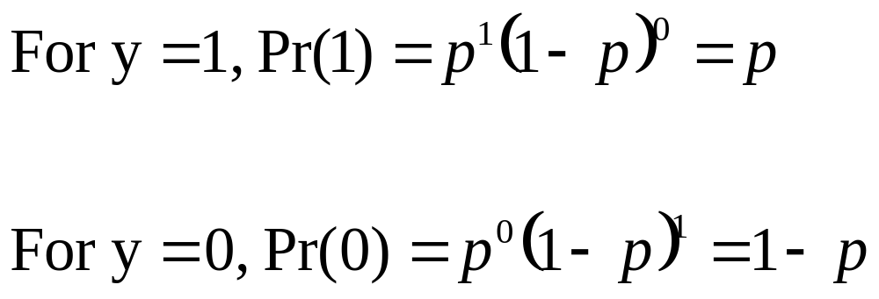
Maximum Likelihood
Define p = Pr(y=1). Then for dichotomous outcome => Pr(y=0) = 1-Pr(y=1) = 1-p. Then:

Slide 26
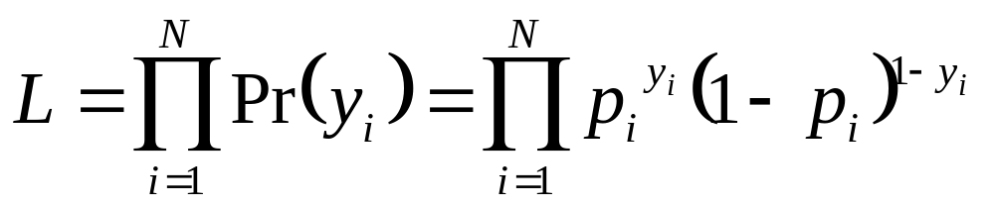
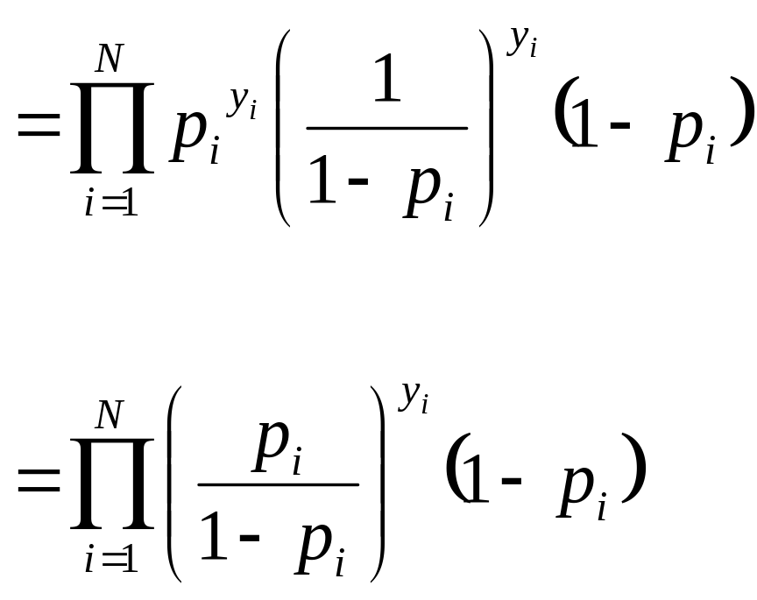
So, given that Pr(y) = p^{y}(1-p)^{1-y} :

Slide 27
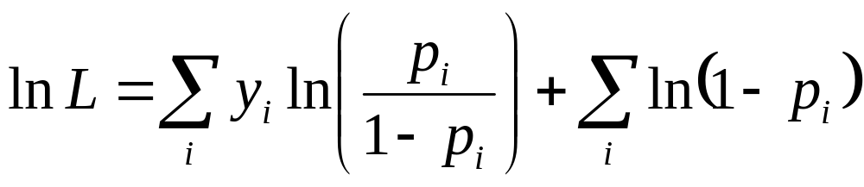
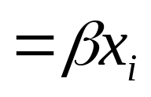
Taking the logarithm of both sides:
Can you see why?
Remember that:

Slide 28
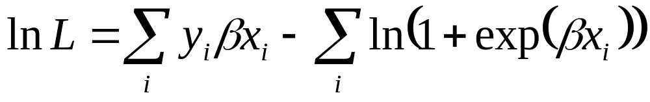
Substituting in using logistic regression model:
Now we choose values of β that make this equation as large as possible.
Maximizing the lnL => maximizes L
Maximizing involves derivatives & iteration

Slide 29
Maximum Likelihood
The method of maximum likelihood estimation chooses values for parameter estimates which make the observed data “maximally likely.”
ML estimators have great properties:
  Unbiased (estimate true β’s)
  Asymptotically efficient (narrow CI’s)
  Asymptotically Normally distributed (can calculate CI’s and Test Statistics using familiar Z formulas)

Slide 30
Estimating a Logistic Regression Model
Steps:
  Observe data on outcome, Y, and charactersitiscs X₁, X₂, …, X_{K}
  Estimate model coefficients using ML
  Perform inference: calculate confidence intervals, odds ratios, etc.

Slide 31
The Logistic Regression Model
predictor variables
dichotomous outcome
is the log(odds) of the outcome.

Slide 32
The Logistic Regression Model
intercept
model coefficients
is the log(odds) of the outcome.

Slide 33
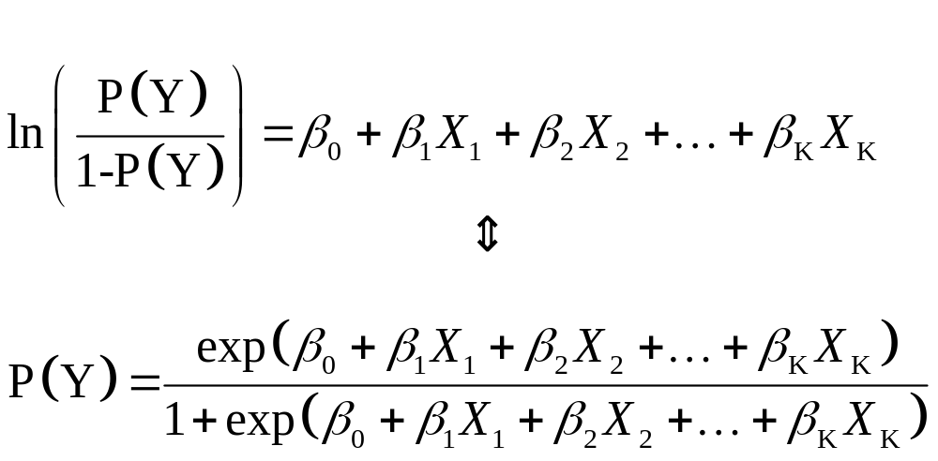
Form for Predicted Probabilities
In this latter form, the logistic regression model directly relates the probability of Y to the predictor variables.

Slide 34
The Logistic Regression Model

Slide 35
Why not use linear regression for dichotomous outcomes?
If we model Y directly and Y is dichotomous, this necessarily violates the linear regression assumptions (homoscedasticity)
One of the more intuitive reasons not to is that will end up with predicted Y’s other than 0 or 1 (possibly more extreme than 0 or 1).

Slide 36
Assumptions in logistic regression
Assumptions in logistic regression
  Y_{i} are from Bernoulli or binomial (n_{i}, μ_{i}) distribution
  Y_{i} are independent
  Log odds P(Y_{i} = 1) or logit P(Y_{i} = 1) is a linear function of covariates

Slide 37
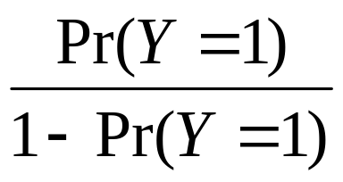
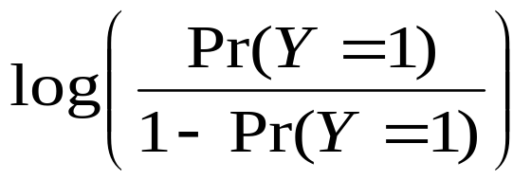
Relationships among probability, odds and log odds
Measure | Min | Max | Name
Pr(Y=1) | 0 | 1 | prob
 | 0 | ∞ | odds
 | -∞ | ∞ | log odds

Slide 38
Commonality between linear and logistic regression
Operating on the logit scale allows a linear model that is similar to linear regression to be applied
Both linear and logistic regression are apart of the family of Generalized Linear Models (GLM)

Slide 39
Logistic Regresion is a
General Linear Model (GLM)
Family of regression models that use the same general framework
Outcome variable determines choice of model
Outcome | GLM Model
Continuous | Linear regression
Dichotomous | Logistic regression
Counts | Poisson regression

Slide 40
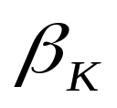
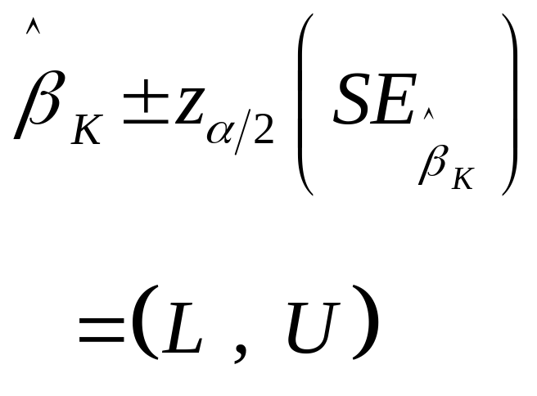
Logistic Regression Models are estimated by Maximum Likelihood
Using this estimation gives model coefficient estimates that are asymptotically consistent, efficient, and normally distributed.
Thus, a 95% Confidence Interval for is given by:

Slide 41
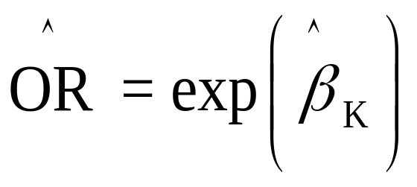
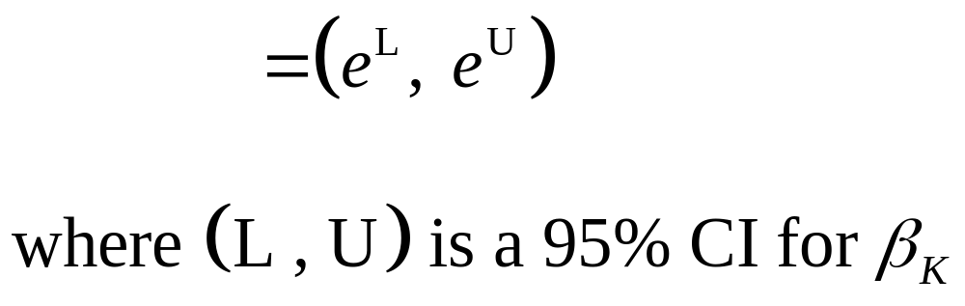
Logistic Regression Models are estimated by Maximum Likelihood
The Odds Ratio for the k^{th} model coefficient is:
We can also get a 95% CI for the OR from:

Slide 42
The Logistic Regression Model
Example:
In Assisted Reproduction Technology (ART) clinics, one of the main outcomes is clinical pregnancy.
There is much empirical evidence that the candidate mother’s age is a significant factor that affects the chances of pregnancy success.
A recent study examined the effect of the mother’s age, along with clinical characteristics, on the odds of pregnancy success on the first ART attempt.

Slide 43
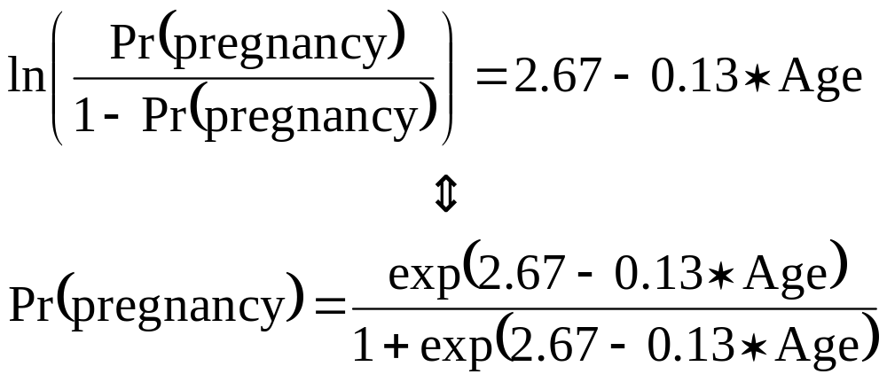
The Logistic Regression Model

Slide 44
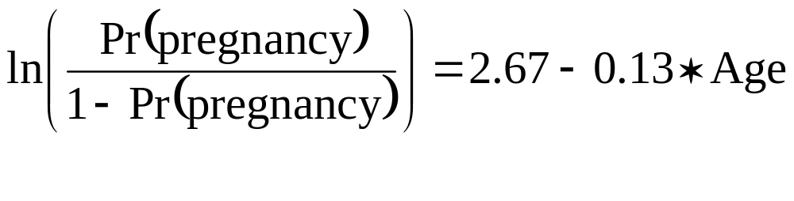
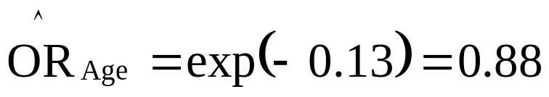
The Logistic Regression Model
Q1. What is the effect of Age on Pregnancy?
A. The
This implies that for every 1 yr. increase in age, the odds of pregnancy decrease by 12%.

Slide 45
The Logistic Regression Model
Q2. What is the predicted probability of a 25 yr. old having pregnancy success with first ART attempt?

Slide 46
The Logistic Regression Model

Slide 47
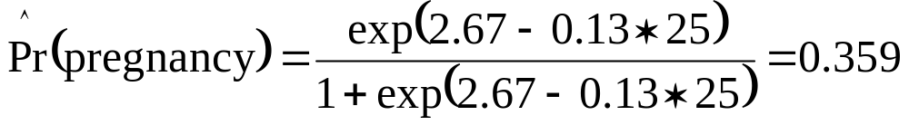
The Logistic Regression Model
Q2. What is the predicted probability of a 25 yr. old having pregnancy success with first ART attempt?
A. From this model, a 25 yr. old has about a 36% chance of pregnancy success.

Slide 48
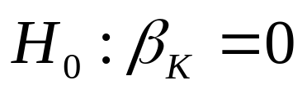
Hypothesis testing
Usually interested in testing
Two types of tests we’ll discuss:
        Likelihood Ratio test
        Wald test

Slide 49

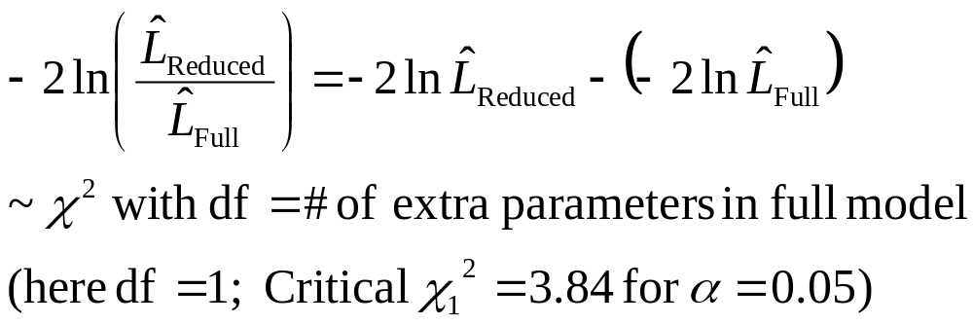
Likelihood Ratio test
Idea is to compare the (log) Likelihood of two models to test
Two models:
        Full model = with predictor included
        Reduced model = without predictor
Then,

Slide 50
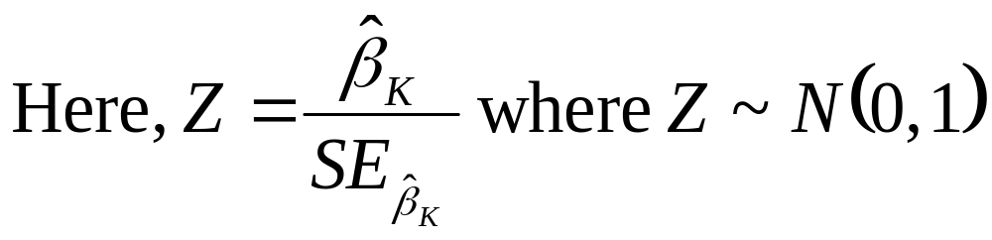
Wald test
Idea is to use large sample Z statistic from a single model to test:
Critical Z value for α=0.05 is 1.96 (two-sided)

Slide 51
Hypothesis testing
As the sample size gets larger and larger, the Wald test will approximate the Likelihood ratio test.
The LR test is preferred but Wald test is common
Why? Not to scald the Wald but…

Slide 52
Predictive ability of Logistic regression
Generalized R-squared statistics controversial
ROC curve plots Sensitivity vs. 1-Specificity based on fitted model
c statistic = Area under ROC curve commonly used to summarize predictive ability of model

Slide 53
SAS Enterprise:
chd.sas7bdat

Slide 54
Logistic Regression
Motivating example
Consider the problem of exploring how the risk for coronary heart disease (CHD) changes as a function of age.
How would you test whether age is associated with CHD?
What does a scatter plot of CHD and age look like?

Slide 55
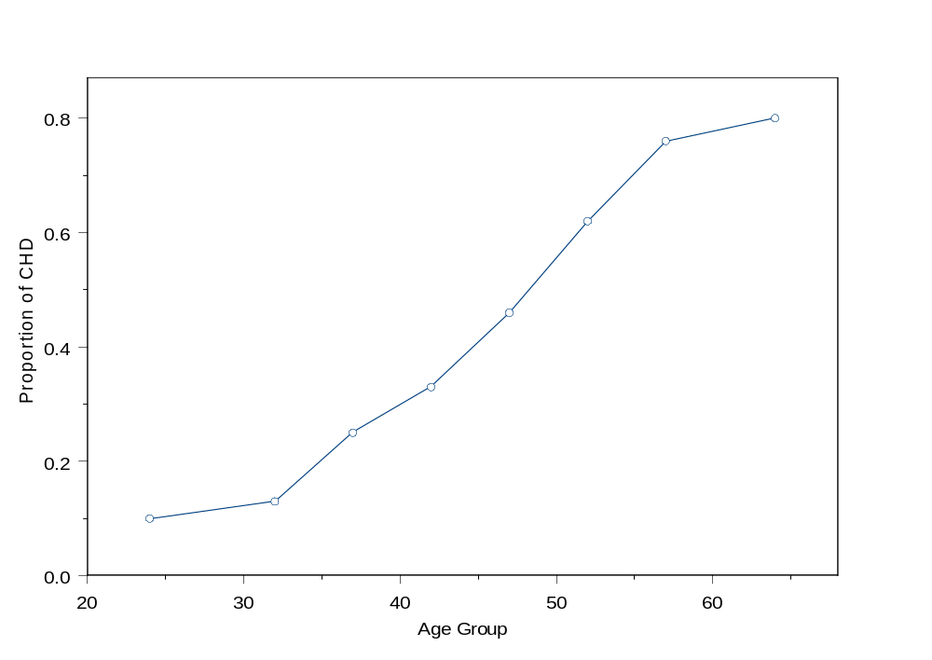

Slide 56
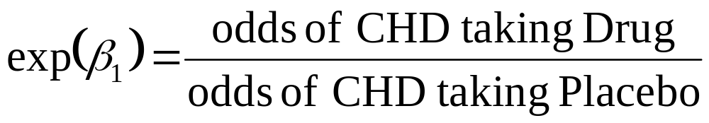
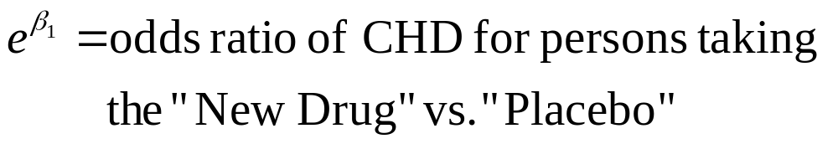
Logistic regression
Taking the exp of β₁ gives the odds ratio:

Slide 57
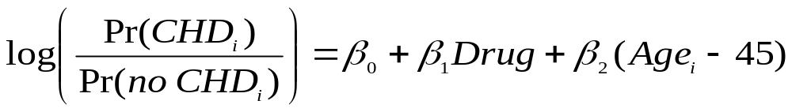
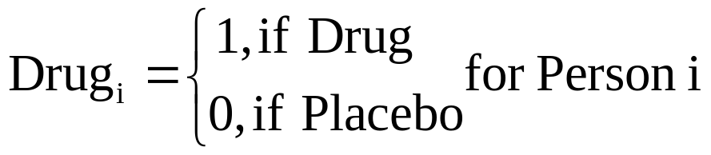
Logistic Regression
We can add multiple predictor variables in modeling the log odds of getting CHD:
Age_{i} = Person i’s age in years

